Slide 1


Chatbot
-Hiking Path
By Group 18
ZHANG Peilai 21433038
ZHENG Haixin 21455651
XIONG Minghao 21422338

Slide 2

PART ONE
01
Interaction

Slide 3

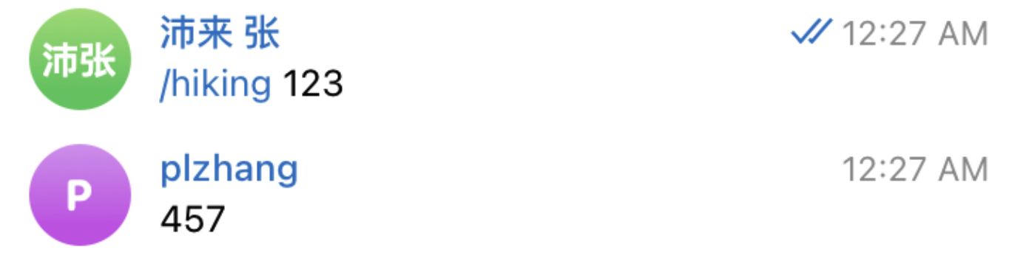
Precise search
We can recommend accurate result which Redis server have.

Slide 4

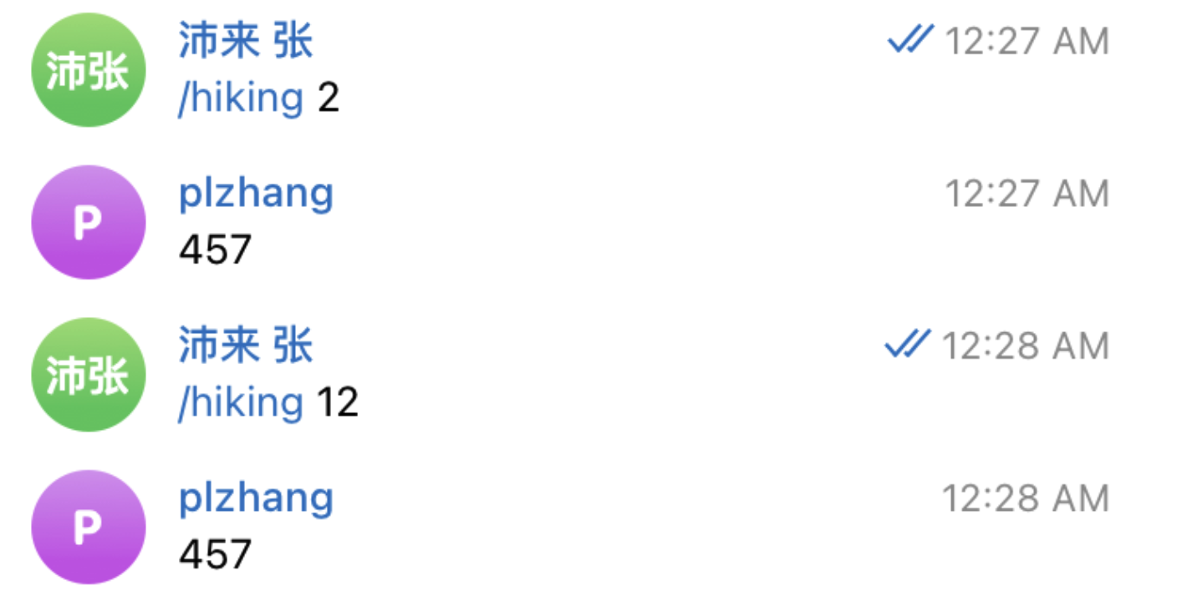
+
We can also recommend some relative information about user’s input or fuzz searching.
Fuzzy search

Slide 5

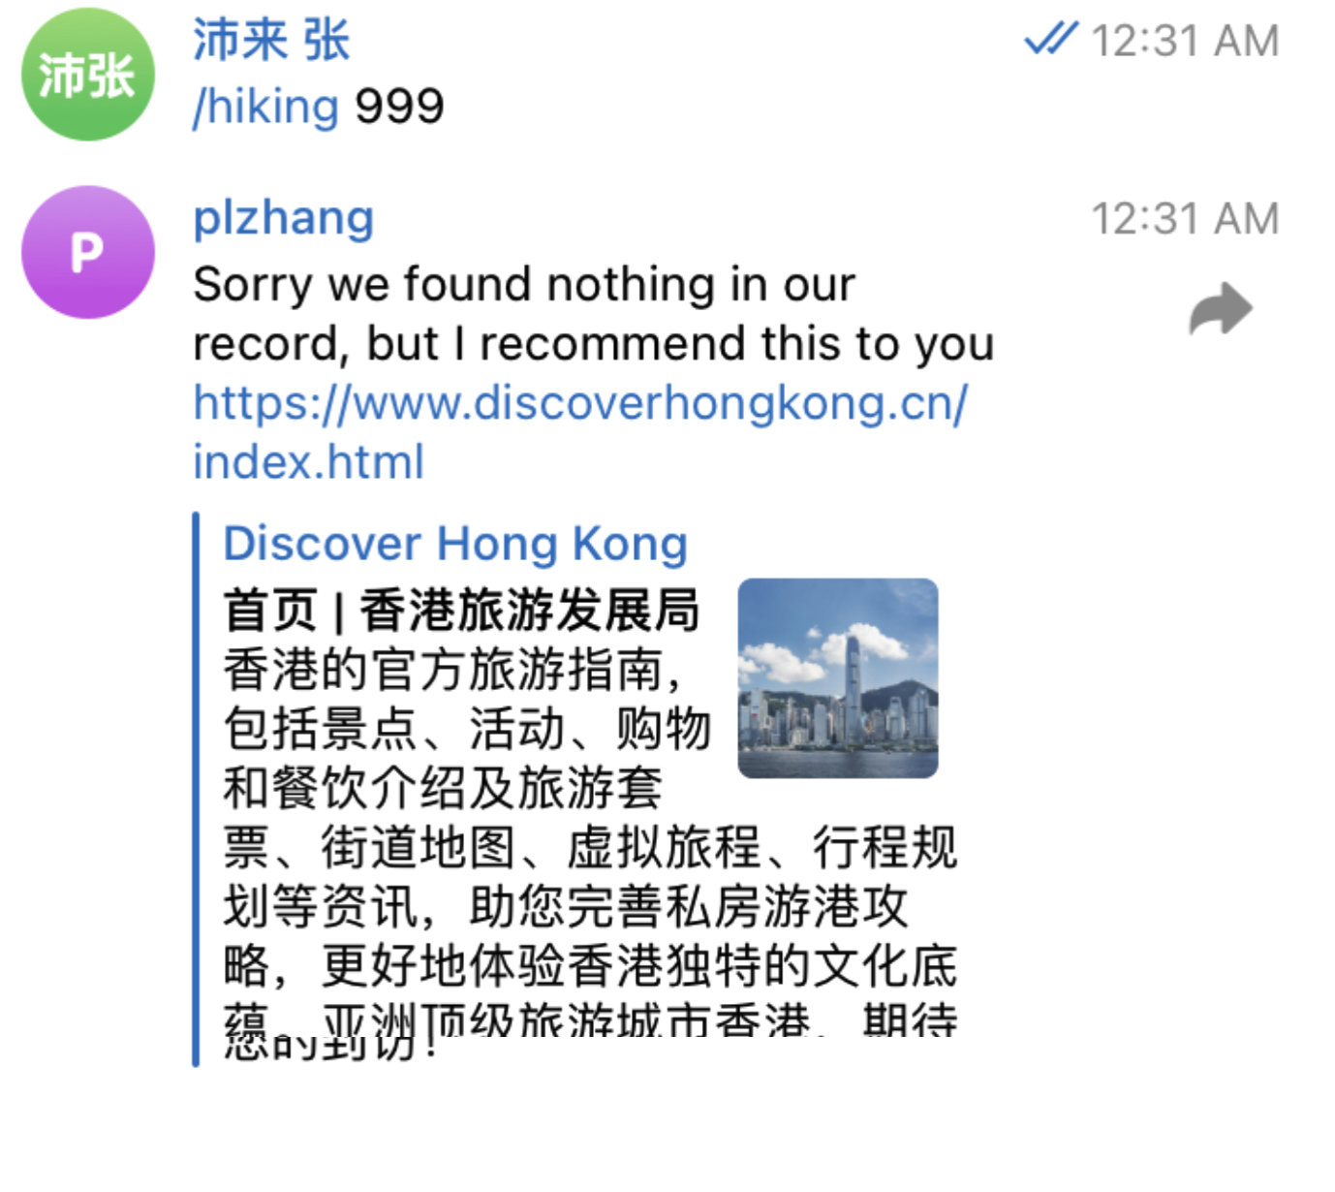
1
Default recommend
For input which we do not have any records or data. We can also recommend something.

Slide 6
PART TWO
02
Platform
Deployment

Slide 7
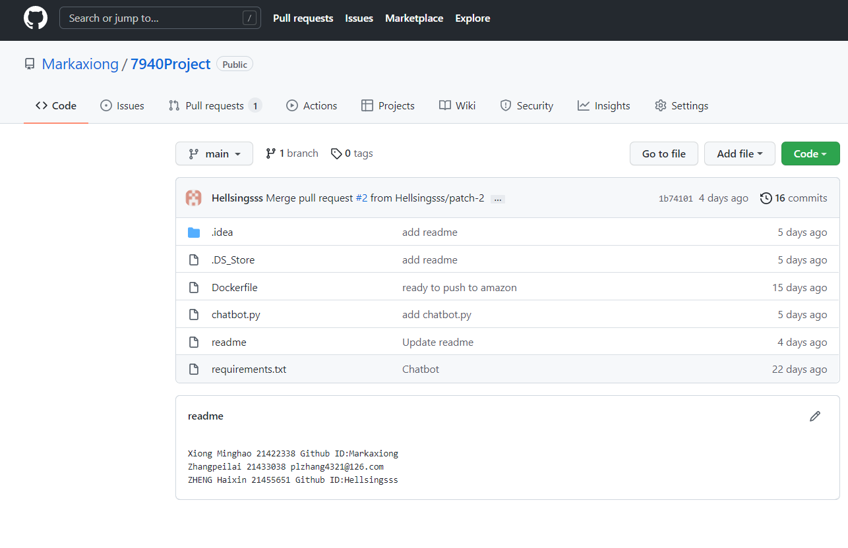
Manage chatbot by git
Xiong Minghao,21422338
2
Github ID:Markaxiong
Our code was managed in my github repository.
My github Account information has been provided in our final report

Slide 8
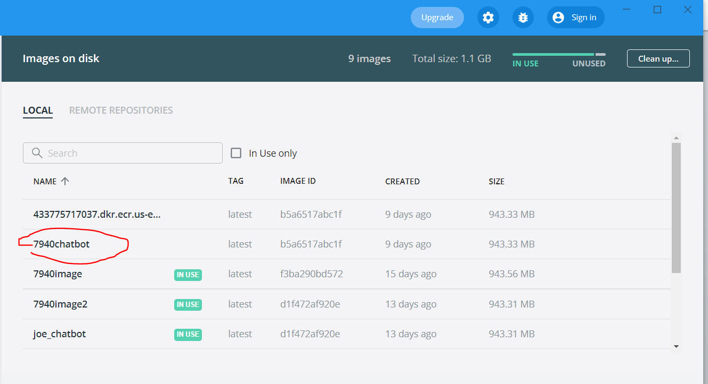
Use container technology
Xiong Minghao,21422338
2
A.
Dockerfile
The ACCESS_TOKEN come from my chatbot. At the same time, the HOST, PASSWORD and REDISPORT come from my teammate Zheng Haixin who is responsible for the part of database service.
B.
Build the image
By the command:
“docker build –t 7940chatbot .”
Container technology also be used in the later hosting part.......

Slide 9
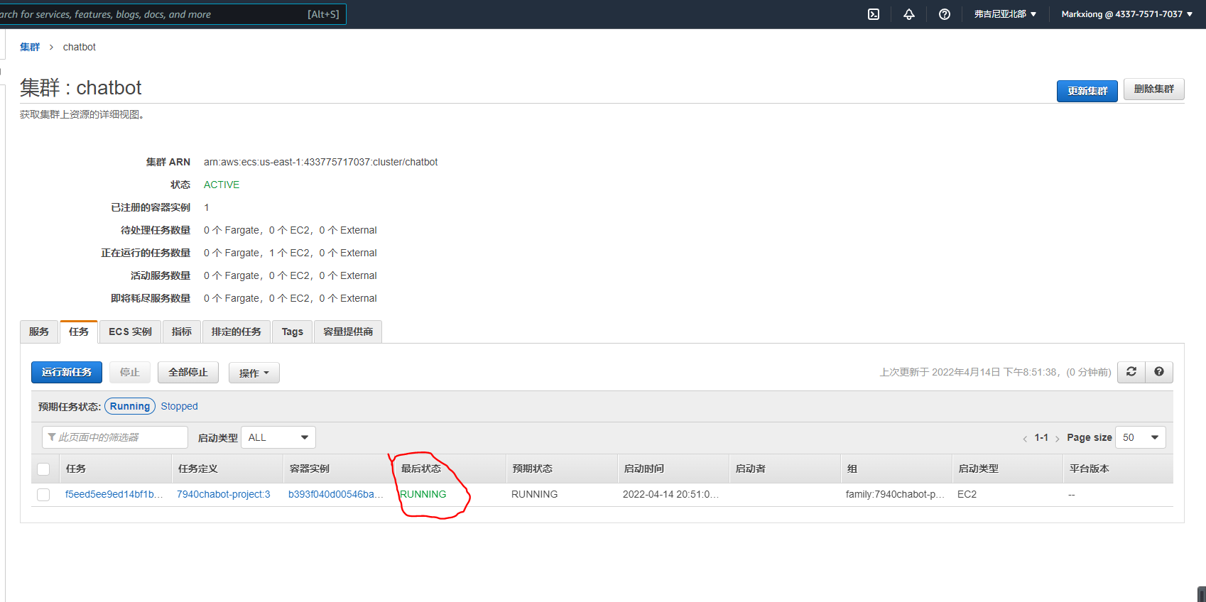
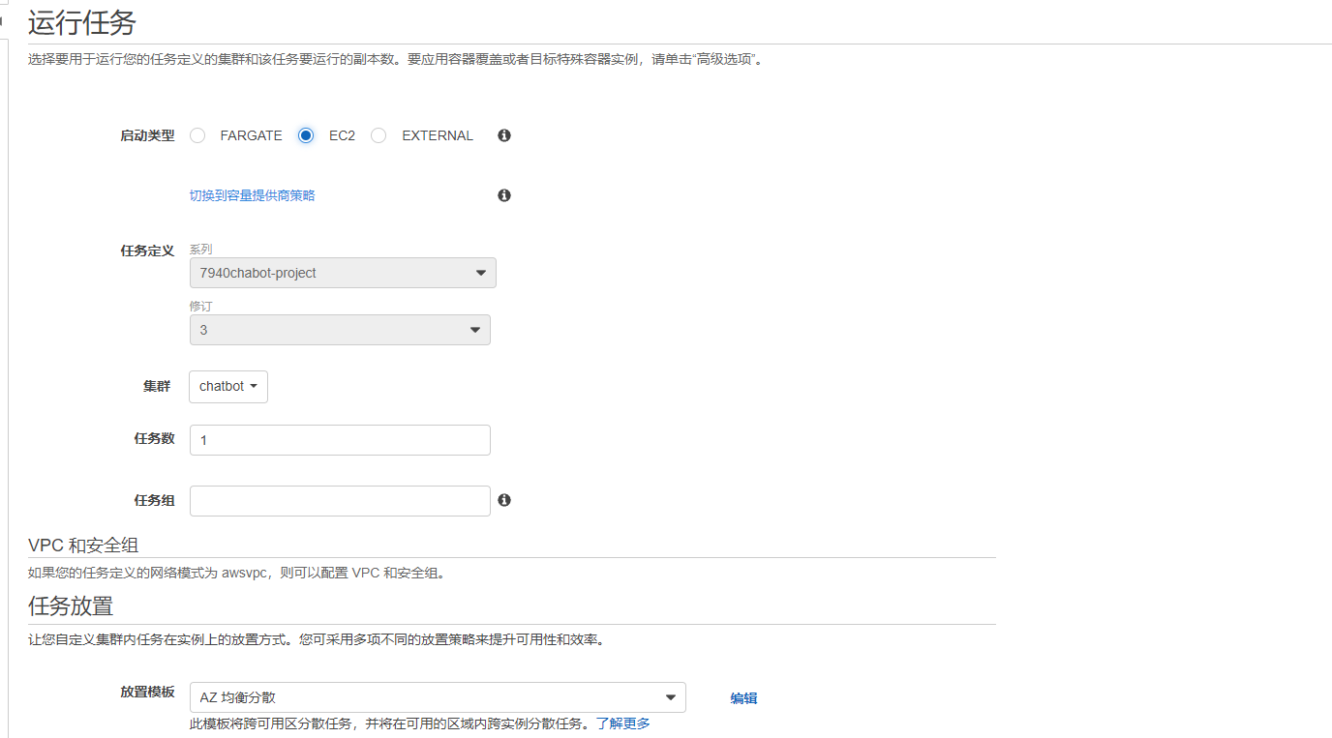
Xiong Minghao,21422338
Host chatbot on the Amazon cloud platform
2
1.Amazon Elastic Container Registry
Push our image to the remote repository of Amazon Elastic Container Registry
(facilitate hosting our App in Amazon Elastic Container Service (ECS) later)
2.Hosting the chatbot on Amazon ECS Platform
1. An amazon ECS cluster must be created. (Run our task request)
2. Add a container through task definition. The image URL obtained from the previous repository of Amazon will be used.
3. When the container deployment is complete, we can run our chatbot in EC2 mode on our cluster defined previously. It shows a running state.
4. Test on my telegram, works well.

Slide 10
PART THREE
03
Database

Slide 11
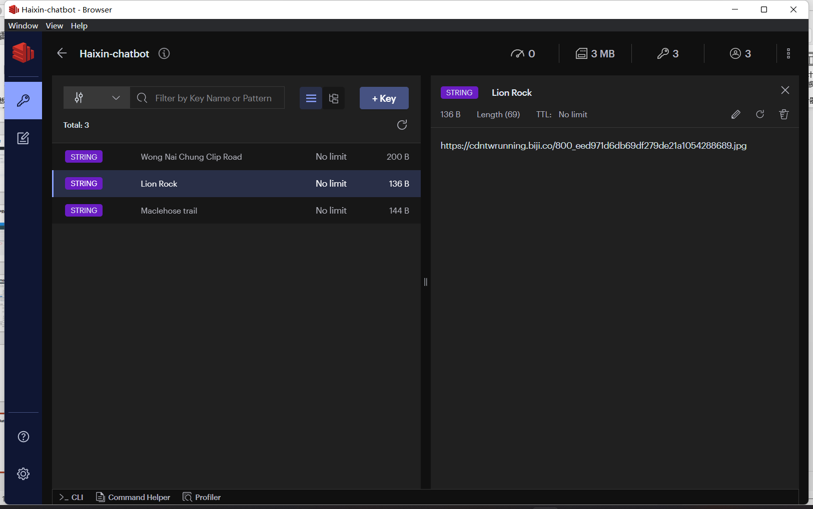
3
RedisInsight manage Data
Use URL represent image
KeyType is STRING
Add three keys for the mountain paths

Slide 12
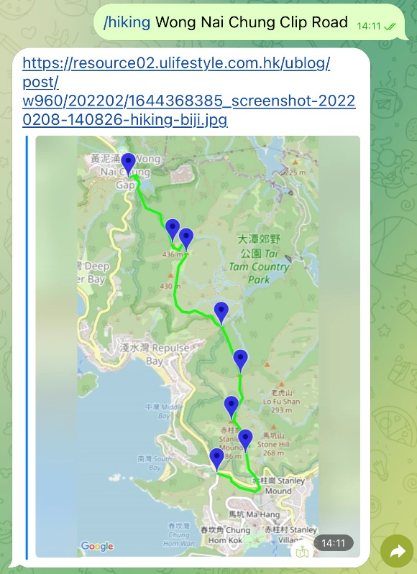
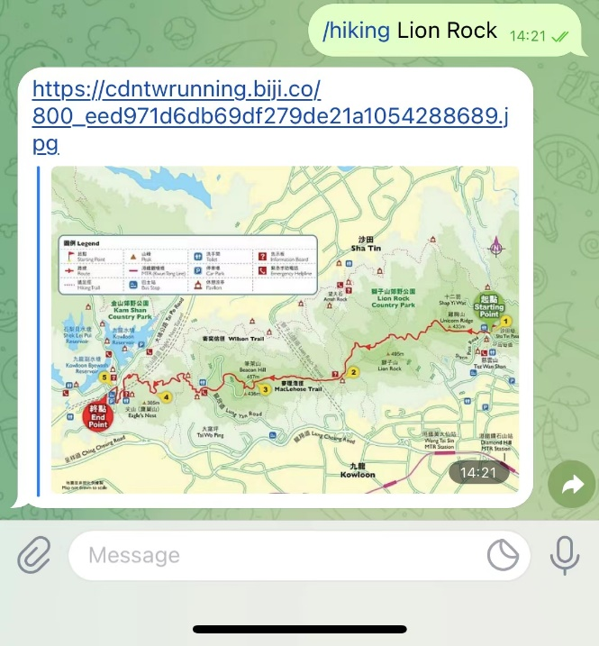
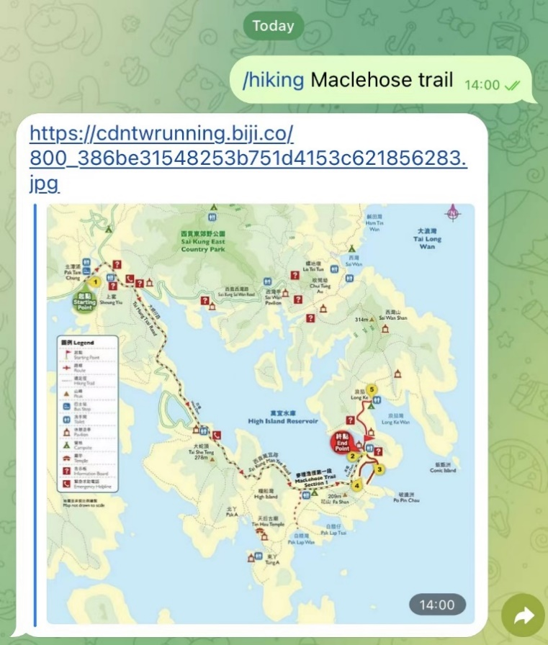
3
Chatbot Display
When enter KEY name(Mountain Path), get the value(image)

